Slide 1


Final Chat App - dragonBall
11/2/2019

Slide 2
Team members
Jiangguo Zhang (team lead)
Yifan Wang (tech lead)
Sibo Wang (doc lead)
Shunda Huang (dev)
Can Sun (dev)
Enze Zhong (dev)
Tingting Zhou (dev)

Slide 3
Contents
Design Decisions
API
Demo
UML Diagram
Design Patterns
Login/Register
Create/Join/Edit a room
Send a message
Leave a room

Slide 4
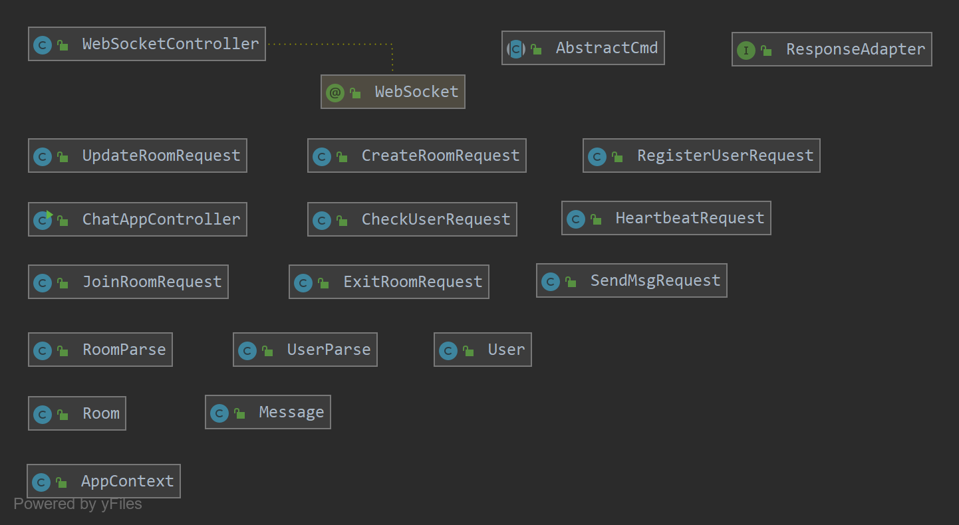
UML Diagram

Slide 5

Design Patterns
Command Design Pattern
Union Design Pattern
Singleton Design Pattern
MVC Design Pattern

Slide 6
MVC Design Pattern
Model
AppContext, ResponseAdapter, etc.
View
GUI
Controller
ChatAppController, WebSocketController

Slide 7
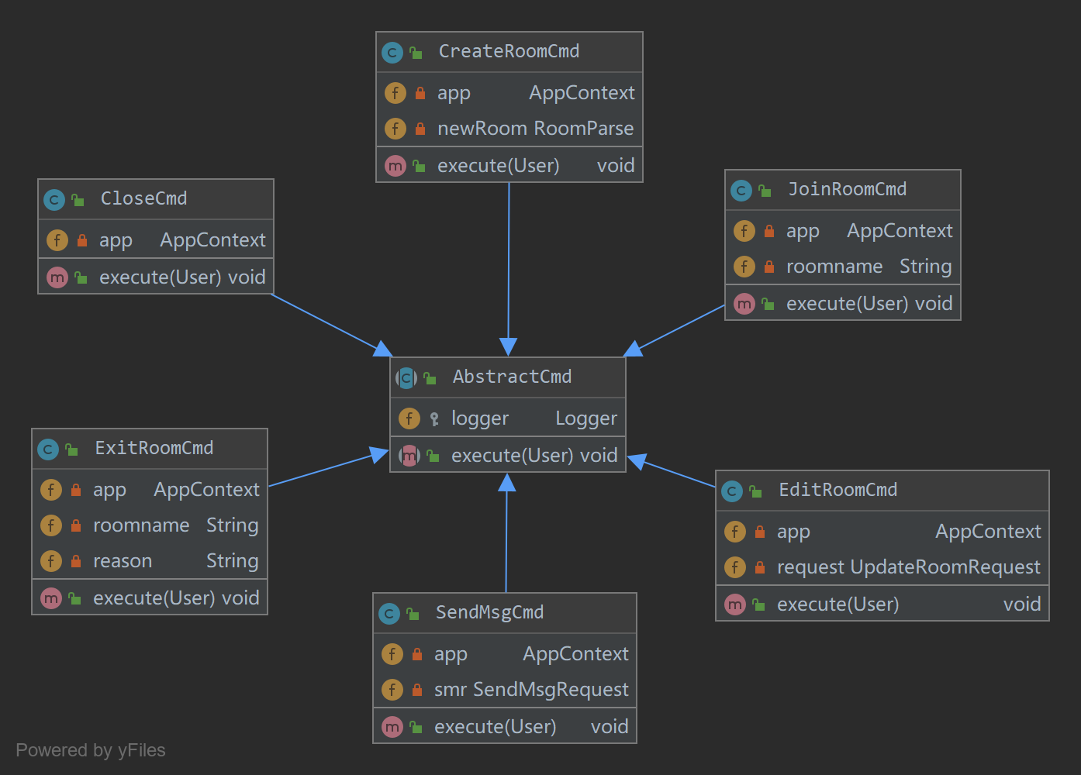
Command Design Pattern

Slide 8
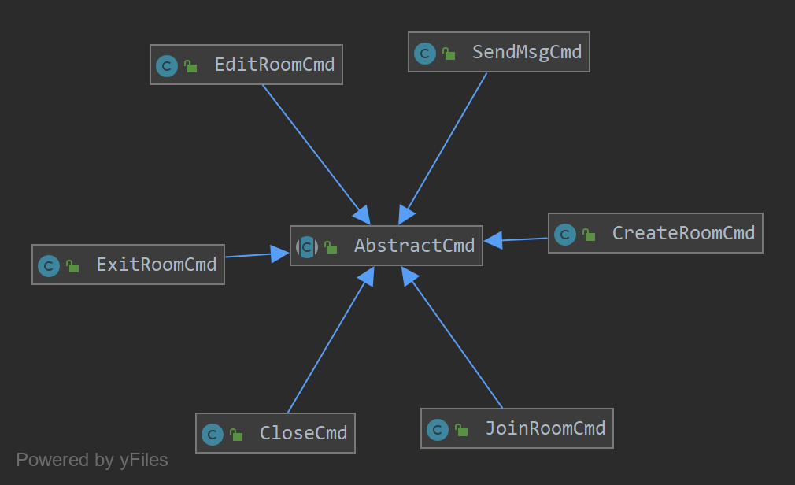
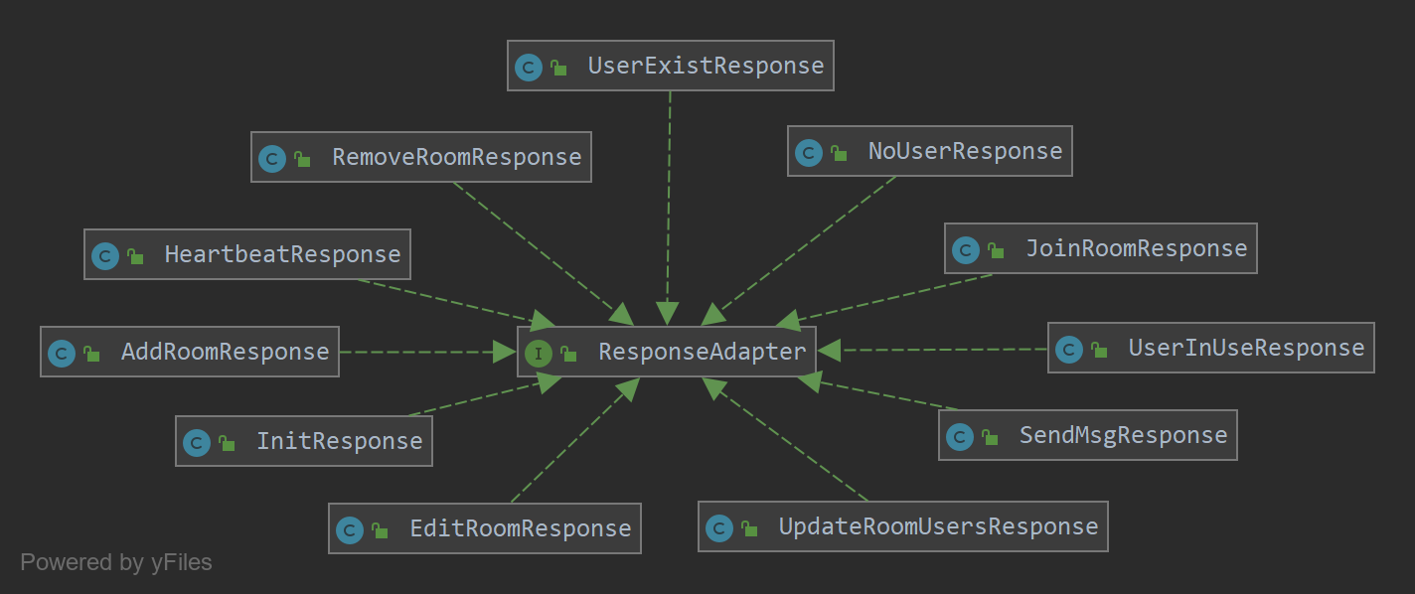
Union Design Pattern

Slide 9
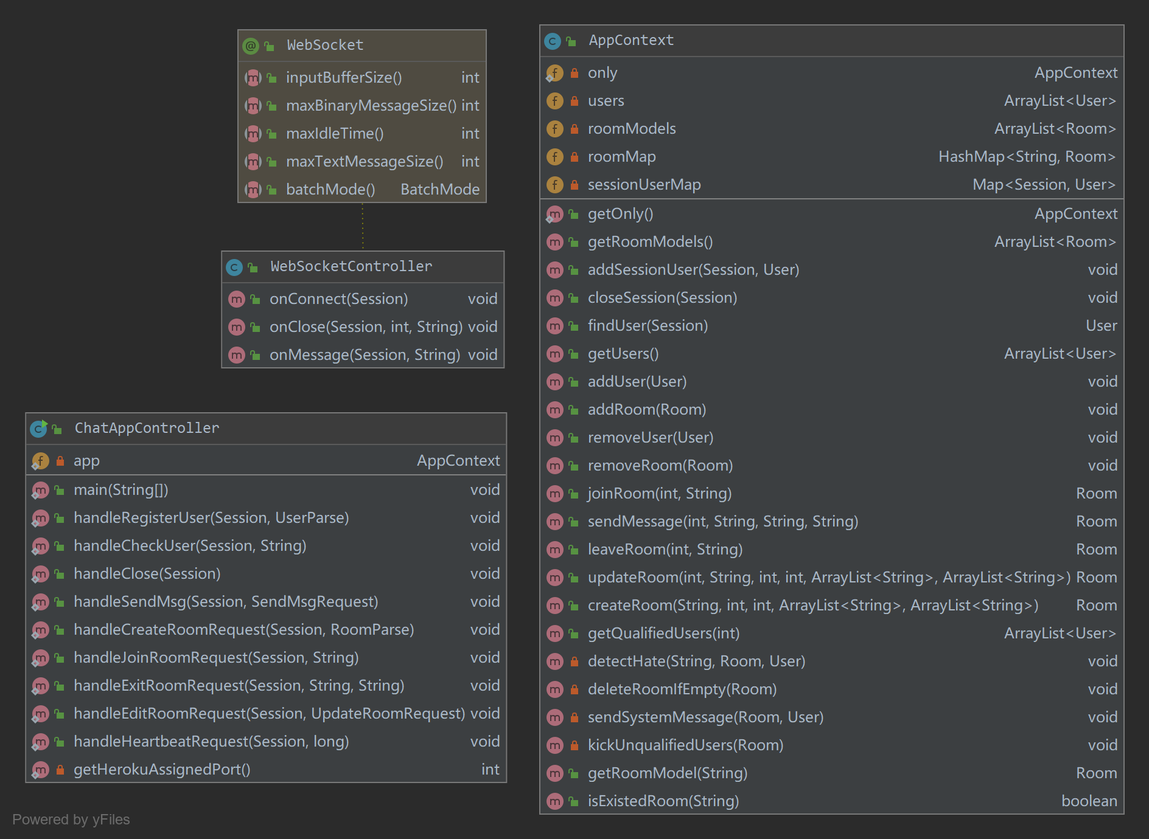
Singleton Design Pattern

Slide 10
Structure
Frontend
react – redux
Data
json
Backend
java

Slide 11
Tool Classes

Slide 12
API
Login/Register
Create/Join/Edit a room
Send a message
Leave a room
Login/Register
Create/Join/Edit a room
Send a message
Leave a room

Slide 13
handleCheckUser
Login/Register
Create/Join/Edit a room
Send a message
Leave a room
Request
checkUserRequest
Payload: username
Logic
Return = user in memory ? data : noUser.
Response
initResponse, noUserResponse, userInUseResponse
User in use.
let user: { username: string, age: number, school: string, area: string };

Slide 14
handleRegisterUser
Login/Register
Create/Join/Edit a room
Send a message
Leave a room
Request
registerUserRequest
Payload: user
Logic
Return = user in use ? userExist : data.
Response
initResponse, userExistResponse
let user: { username: string, age: number, school: string, area: string };

Slide 15
handleCreateRoom
Login/Register
Create/Join/Edit a room
Send a message
Leave a room
Request
createRoomRequest
Payload: room
Logic
Return = room exist ? none : new room.
Response
addRoomResponse, sendMsgResponse
let room : { owner: string, roomname: string, ageMin: number, ageMax: number, areas: string[], schools: string[], users: string[], msgs: typeof msg[] };
Notes:
A user must initiate the creation of a chat room
One of the users in the chat must be the owner
Owners can restrict the type of user that can join the chat room by
Age
Location (Continent, owner may choose more than one continent, e.g. North and South America)
School (Rice, Harvard, Duke, Nanjing, Wuhan, etc…)
A user has a profile that includes their age, location, and school
A user can determine who is in the chat room

Slide 16
handleJoinRoom
Login/Register
Create/Join/Edit a room
Send a message
Leave a room
Request
joinRoomRequest
Payload: roomname
Logic
Send message to user and other members in the room.
Response
sendMsgResponse, joinRoomResponse, updateRoomUsersResponse
Update user list in the room.
Notes:
A user may be in multiple chat rooms
A user can join a chat room if they are qualified to join
A user can determine what chat rooms they have joined and what rooms they can join

Slide 17
handleUpdateRoom
Login/Register
Create/Join/Edit a room
Send a message
Leave a room
Request
updateRoomRequest
Payload: roomname, ageMin, ageMax, areas, schools
Logic
Update constraint and send system message.
Response
addRoomResponse, sendMsgResponse, removeRoomResponse
Kick unqualified members. Update rooms for other members.

Slide 18
handleSendMsg
Login/Register
Create/Join/Edit a room
Send a message
Leave a room
Request
sendMsgRequest
Payload: roomname, msg
Logic
Response
sendMsgResponse
Send message to target.
Detect “hate”.
let msg: { from: string, to: string, toAll: boolean, text: string, isSysMsg: boolean, timestamp: number };
Notes:
A user can only send a message to someone else in the same chat room as them
A user should be notified that their message has been received
A user will forcibly be removed from all chat rooms if the user uses the word “hate” in a message.
Only owners can send a single message to all users in the chat room
When user1 sends a message to user2, user1's message should only appear on user1 and user2's screen. It should not appear on user3's screen.
Messages should appear on separate lines on the chat app screen
If message msg2 is sent after message msg1, msg2 should appear on the screen below msg1

Slide 19
handleExitRoom
Login/Register
Create/Join/Edit a room
Send a message
Leave a room
Request
exitRoomRequest
Payload: roomname
Logic
Delete room if no member. Assign new owner if owner exit.
Response
sendMsgResponse, removeRoomResponse, updateRoomUsersResponse
Exit room, send system message and update room info.
Notes:
A user can choose to exit one chat room or all chat rooms
If a user leaves a chat room, if should be clear to the other users why the user left (voluntarily left, connection closed, forced to leave)

Slide 20
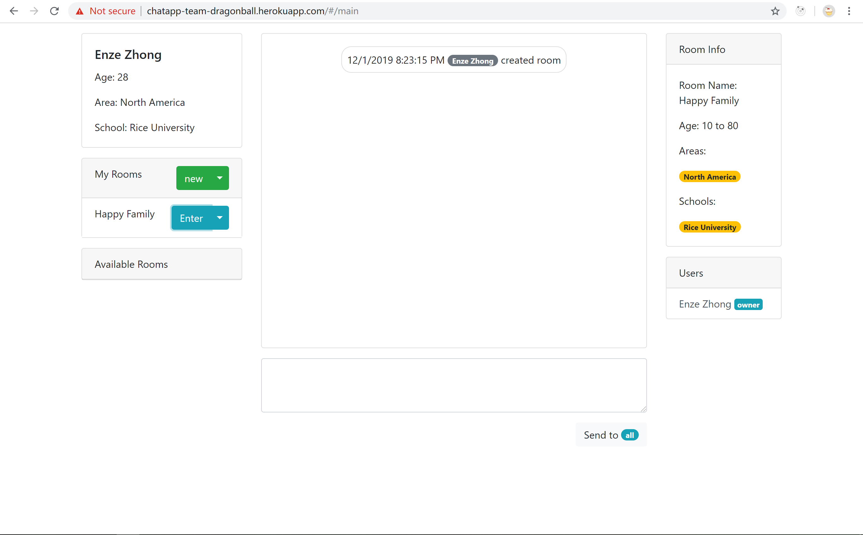
Demo
http://chatapp-team-dragonball.herokuapp.com

Slide 21

Thank you!

